Slide 1
Saaransh Mishra (8064)
Akshat Das(8007)
Prince Raj(8012)
Kartik Goel(8059)
iQuensAns
A community for like-minded people to connect with each other and share their learning among others.

Slide 2
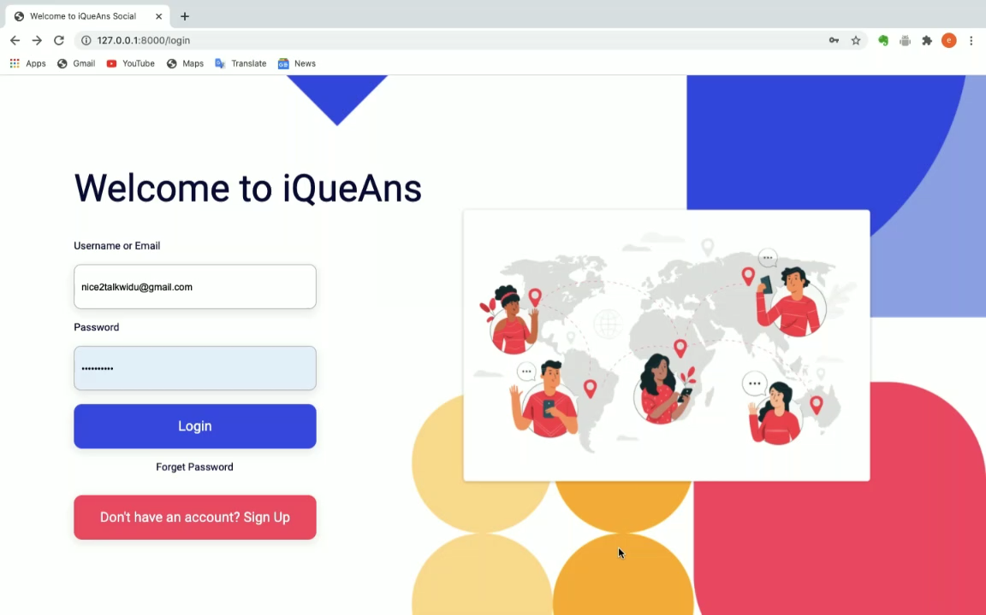

Slide 3
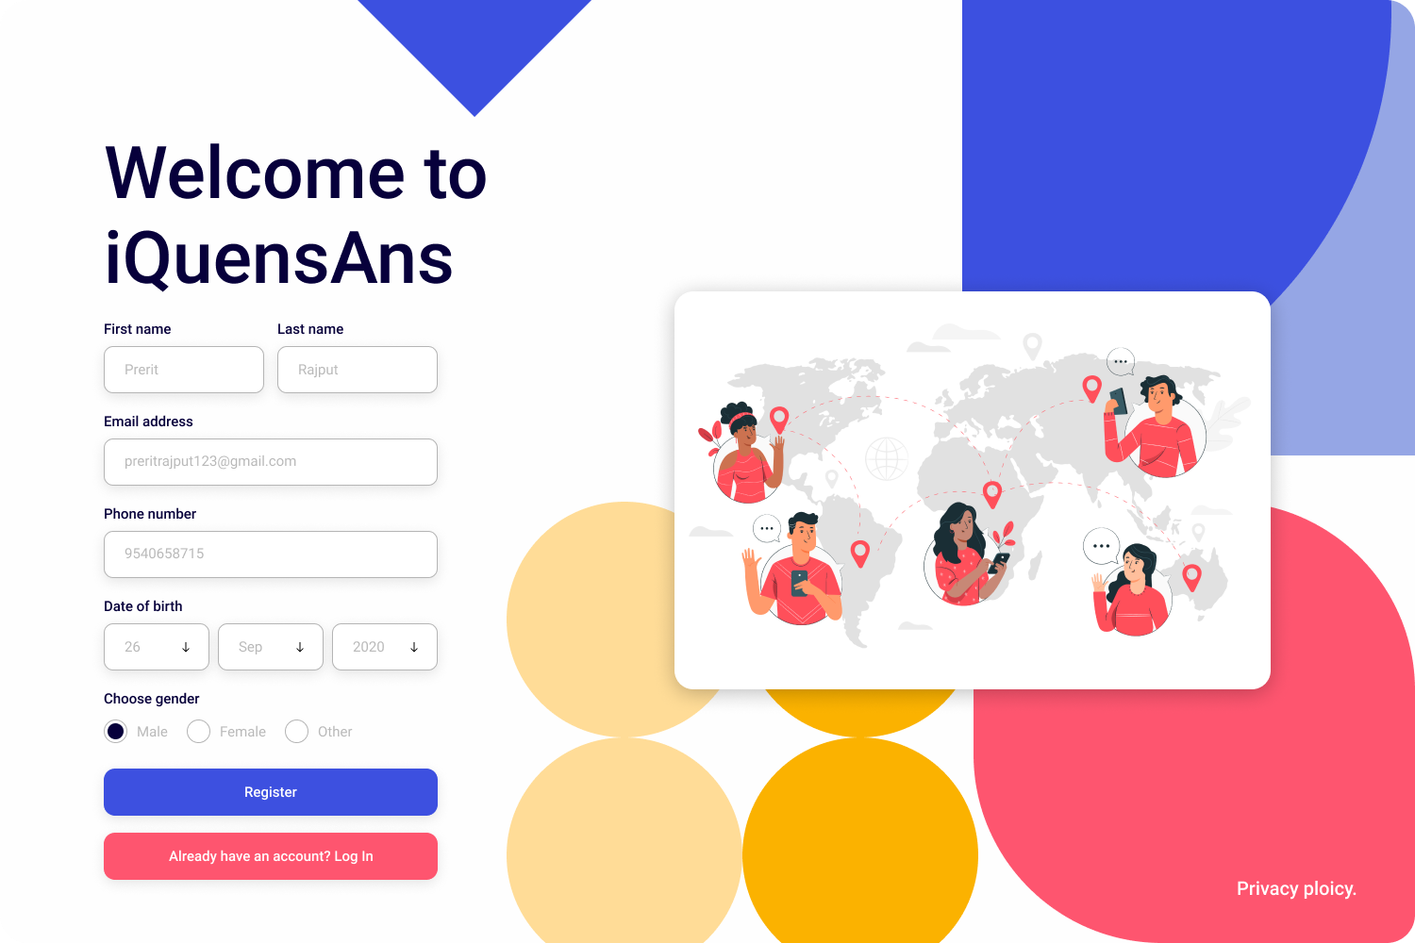
Sign up
Page
Overview
iQuensAns is a platform where like-minded people can share their learnings and they can post their questions as well. People would take part in it and try to answer it out.

Slide 4
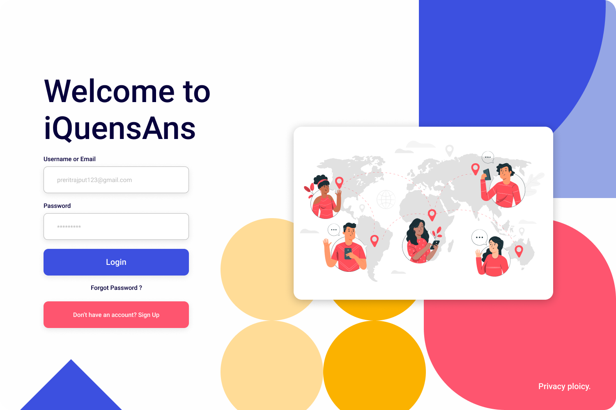
Log in Page
Overview
When user will type their credentials it will authenticate via database and if typed credentials is correct, a status code 200 will be login the user into the dashboard.

Slide 5
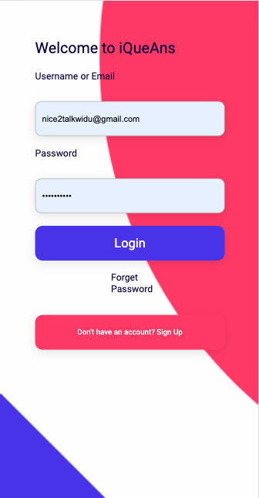
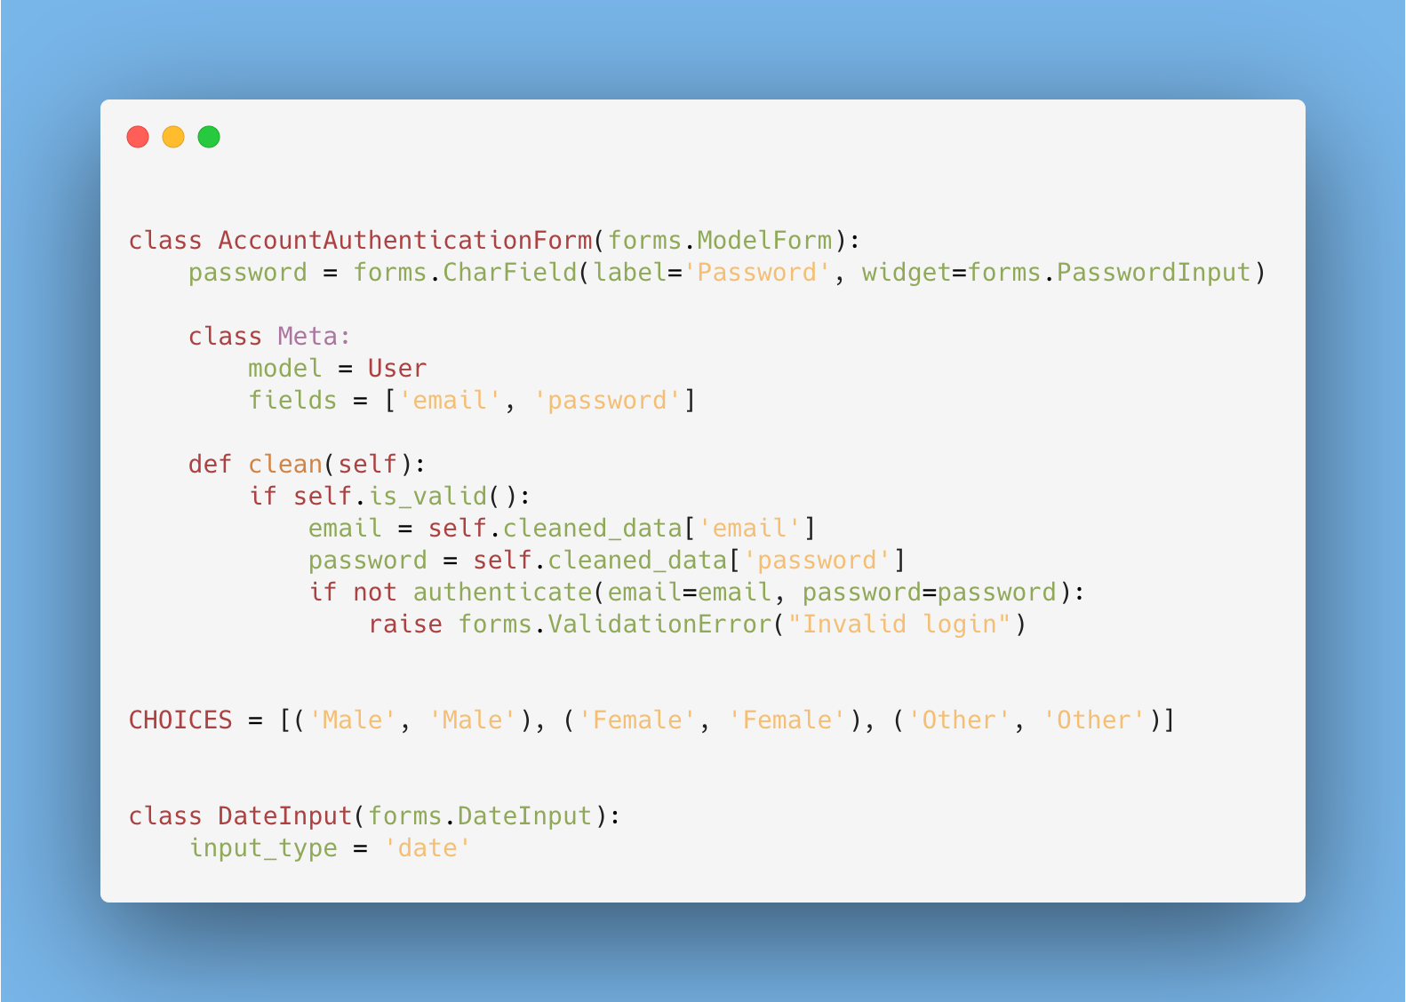
Log in Form

Slide 6
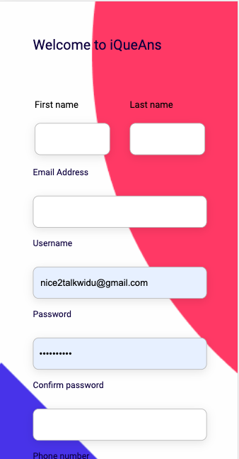
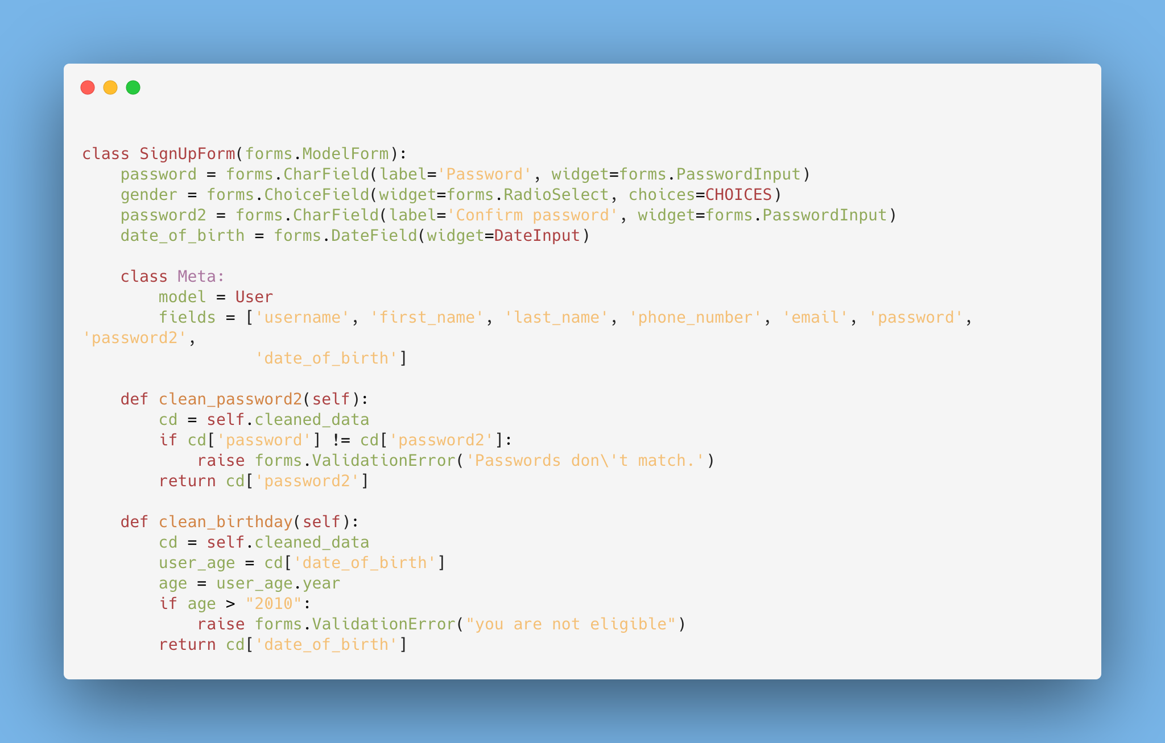
Sign up Form

Slide 7
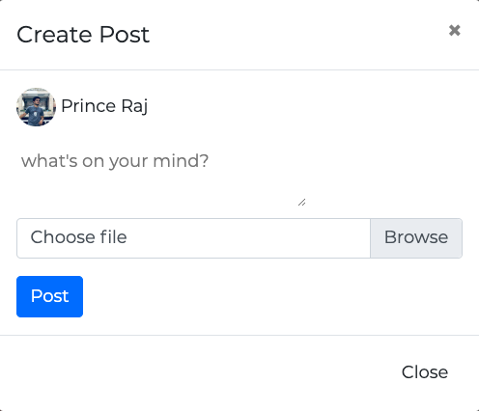
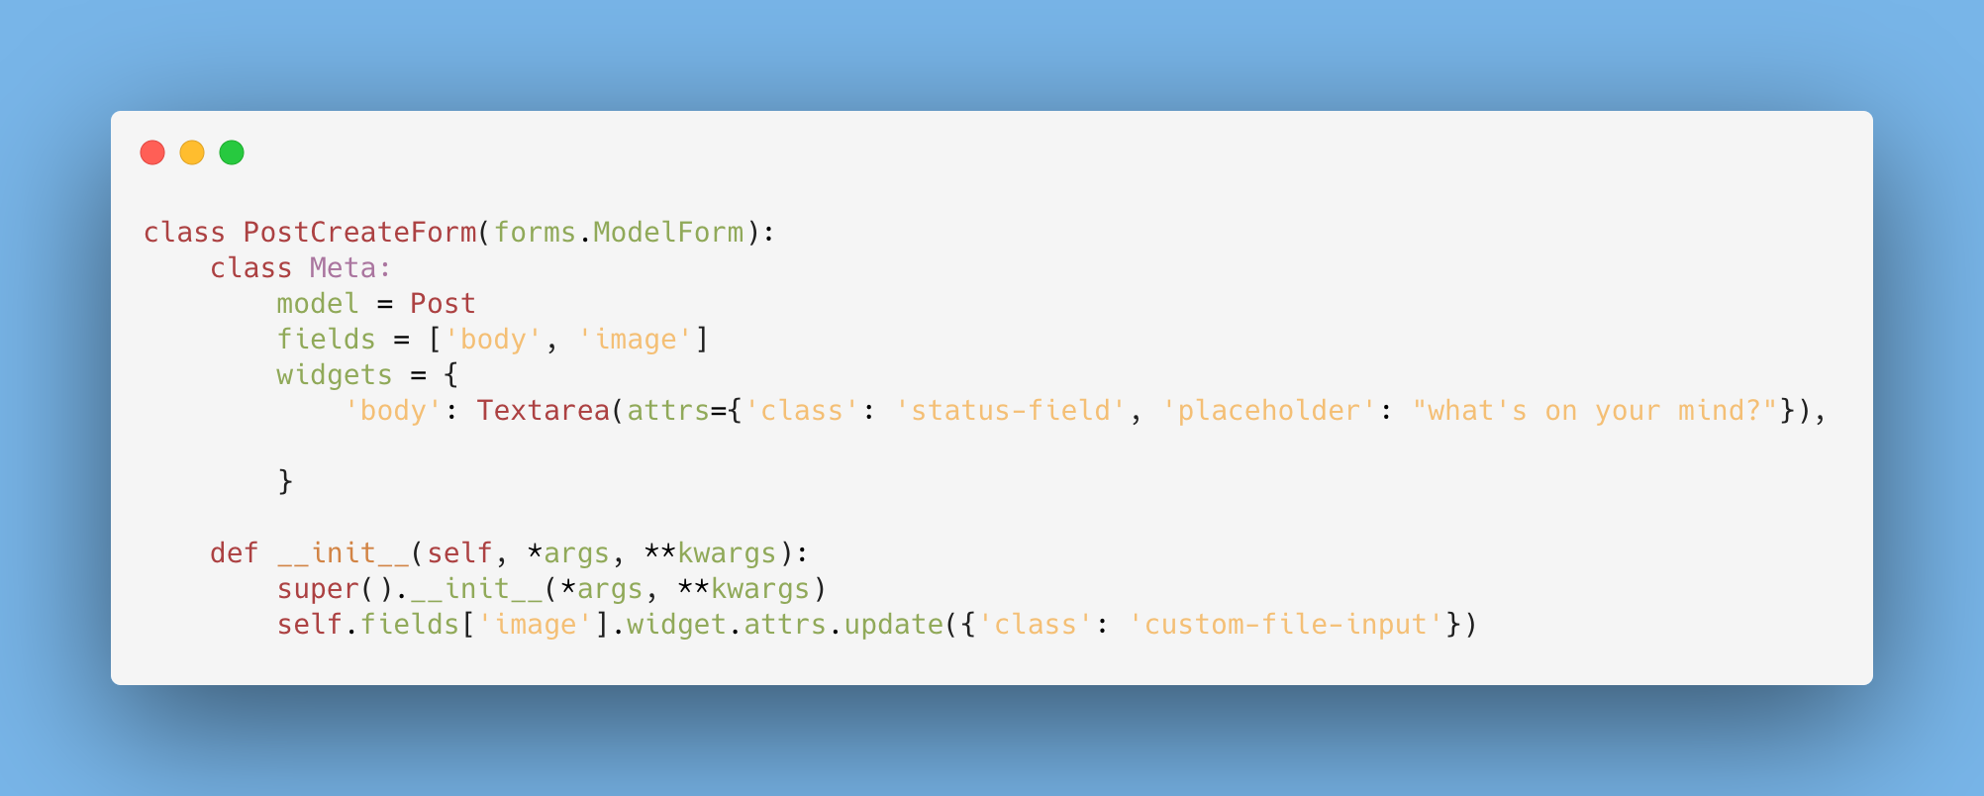
Post Create Form

Slide 8
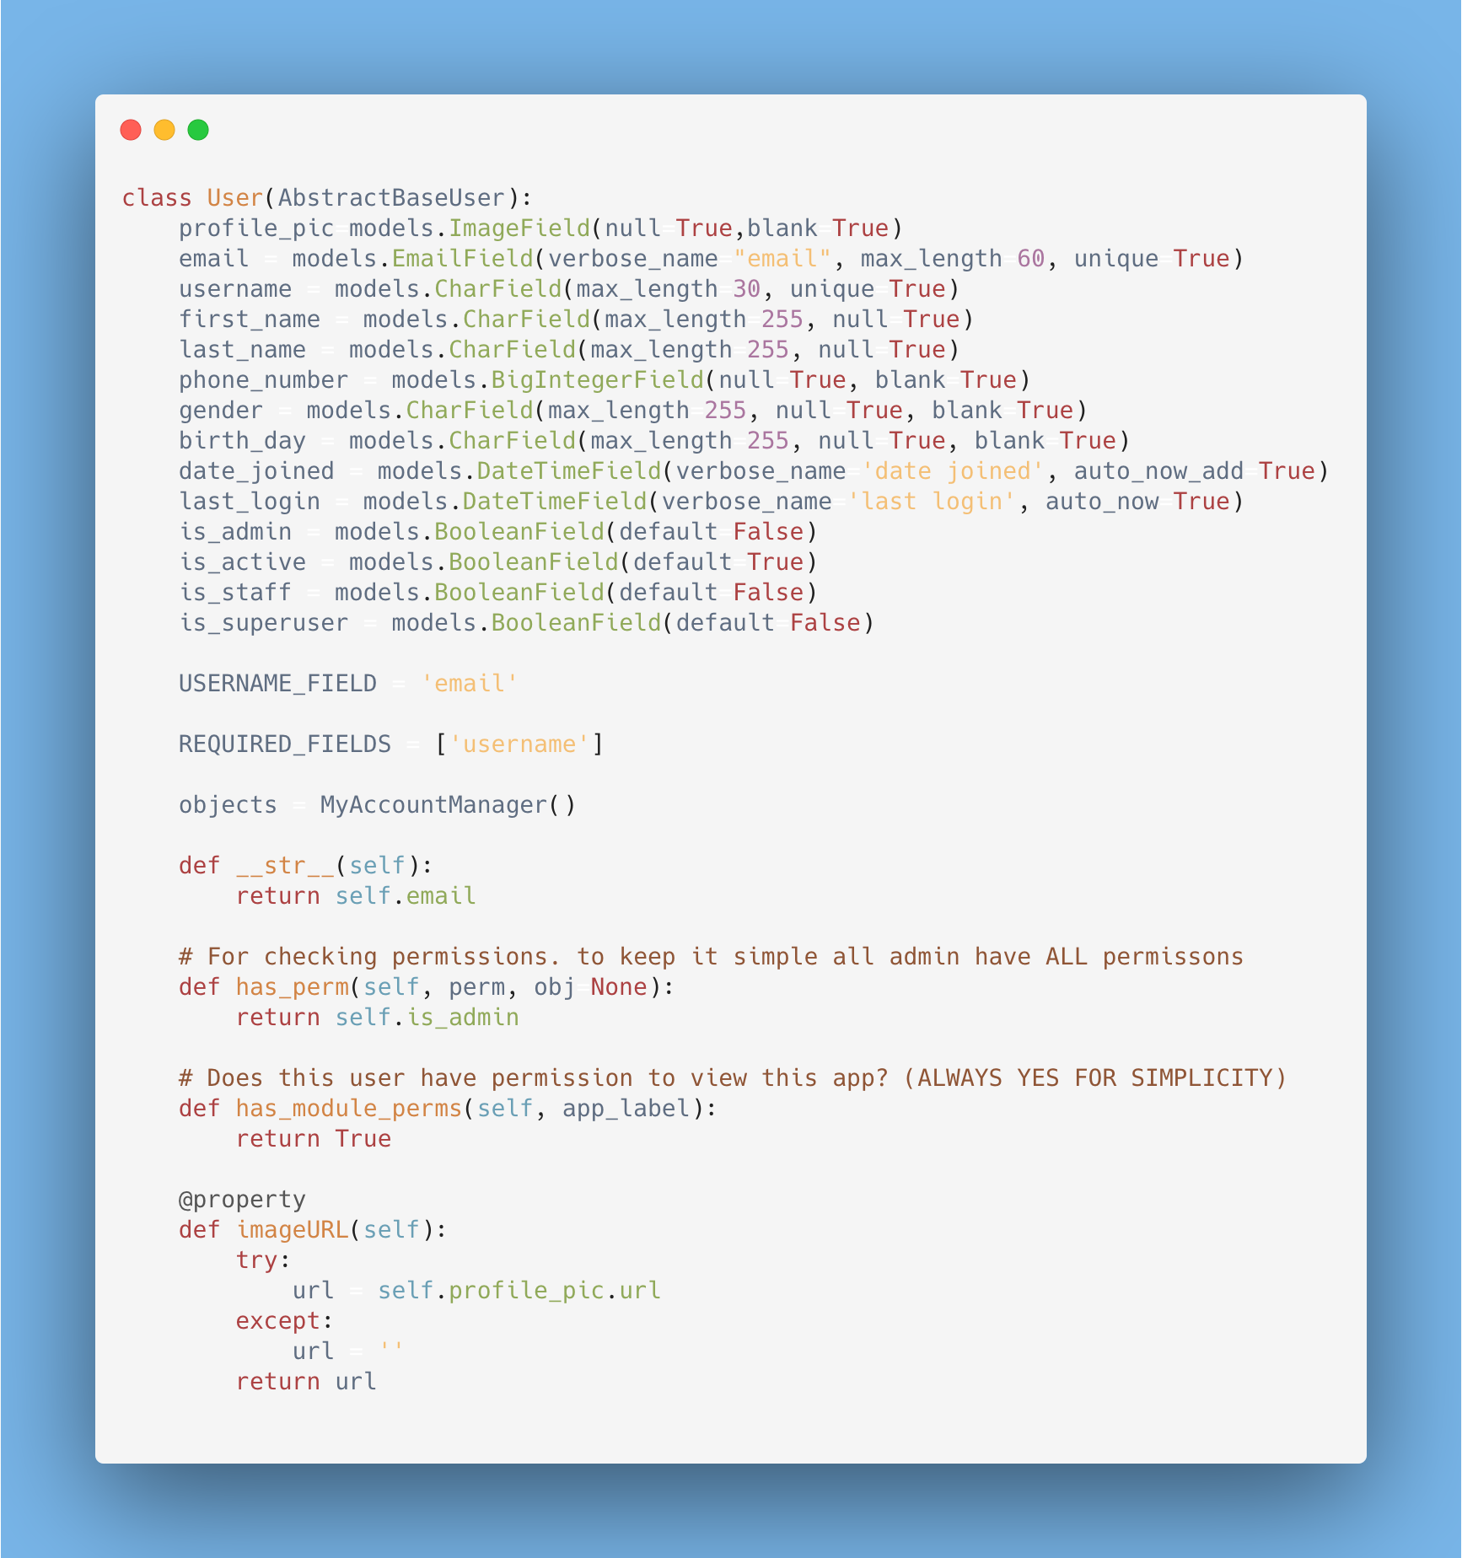
User
Model
We are creating a custom user model, because we need to add some additional field like date of birth and gender.
Since Django only comes up with username and password field. We also need to import this model to a create a form corresponding to it.
It will be done in forms.py file.
Prince Raj

Slide 9
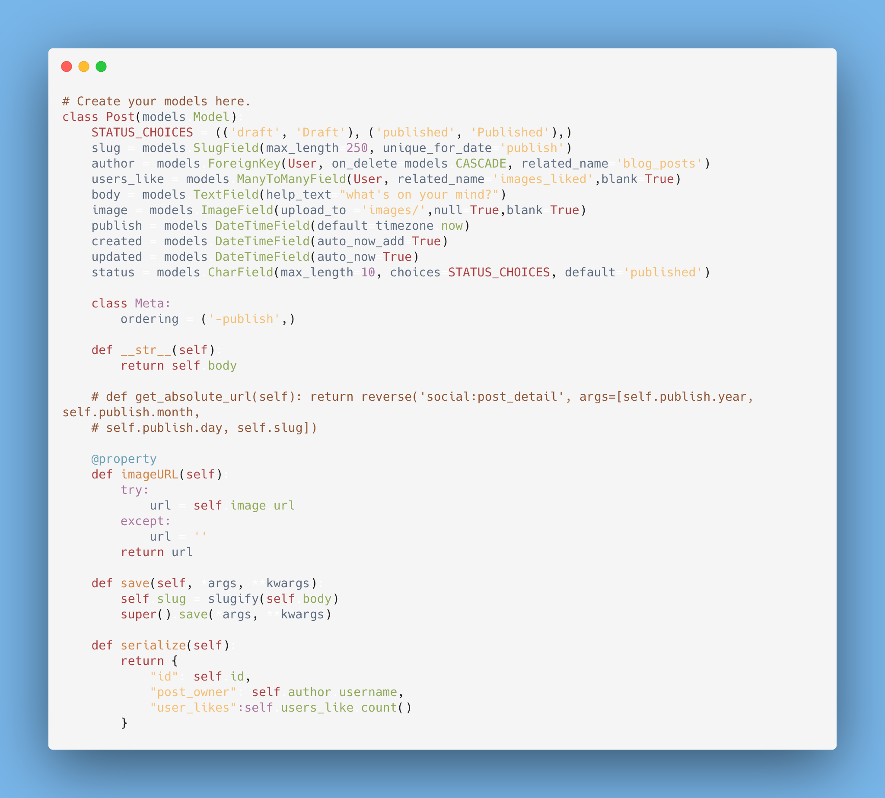
Post
Model
Here, we have created a post model in models.py file so django can create a database based on it which also will be written in SQL.

Slide 10
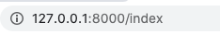
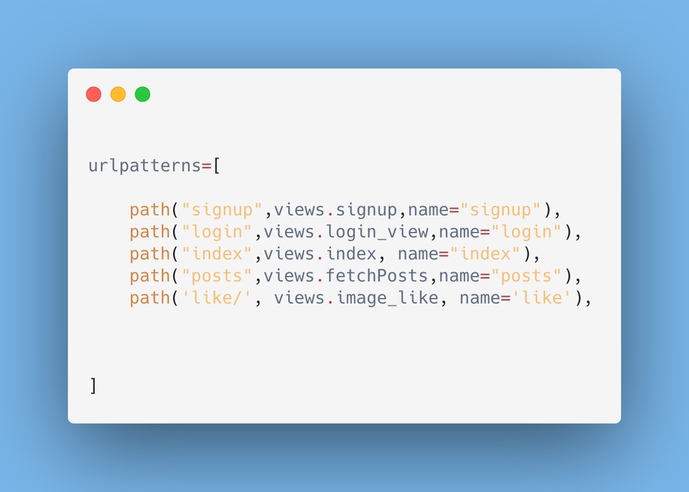
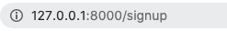
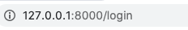
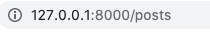
App Level Routes

Slide 11
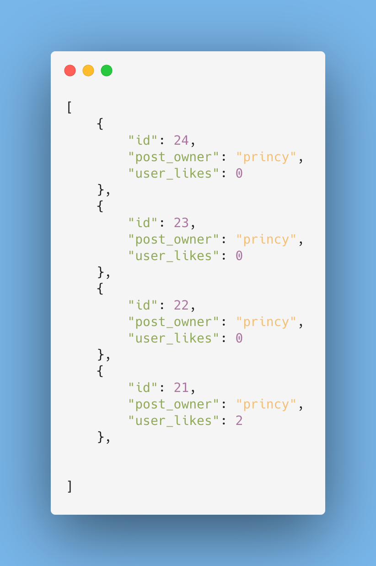
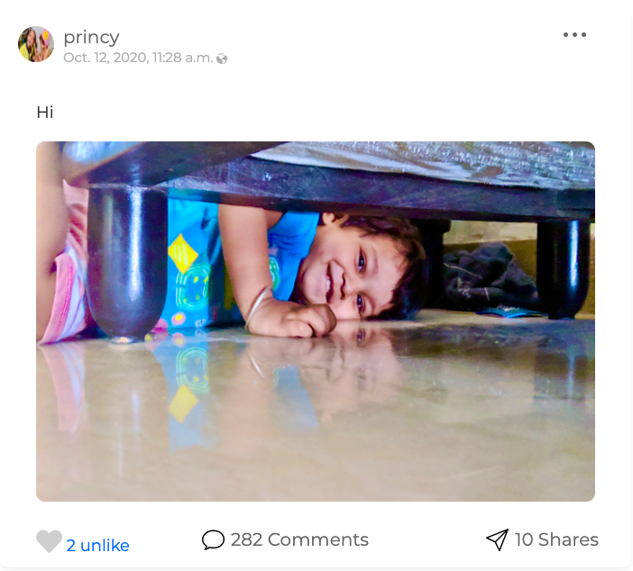
Fetch Posts like using API

Slide 12
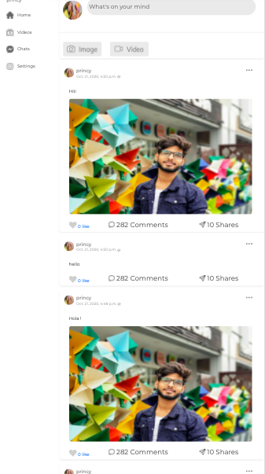
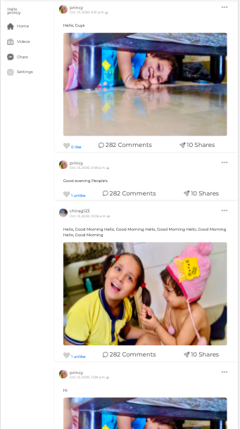
Mobile
View
Compatible on every screen sizes. For that media queries has been used.
@media only screen and (max-width: 1020px)

Slide 13
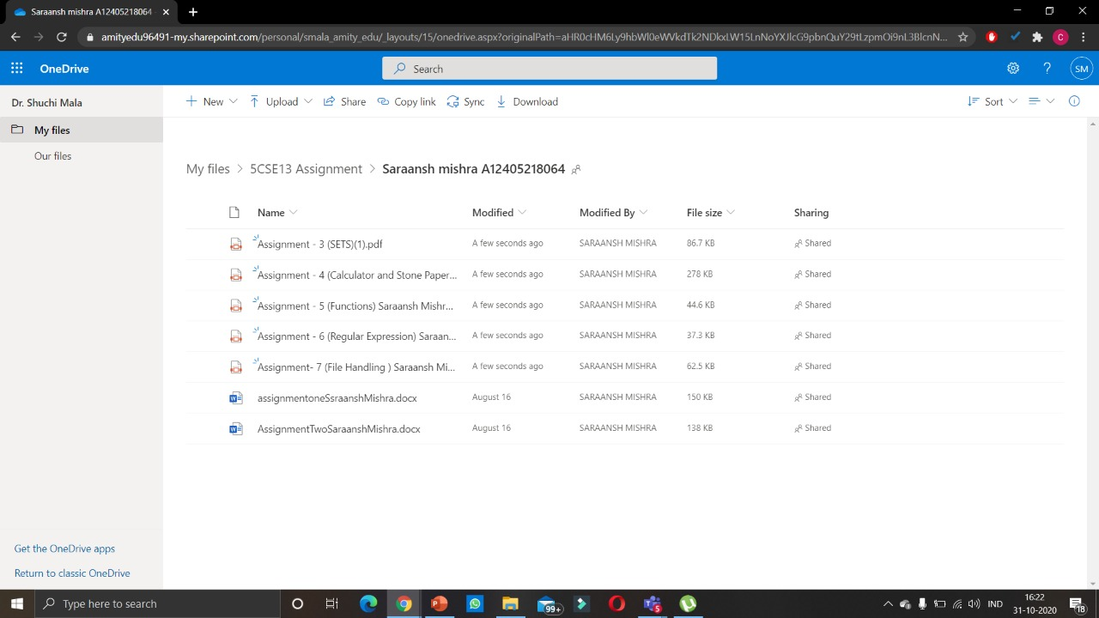

Slide 14
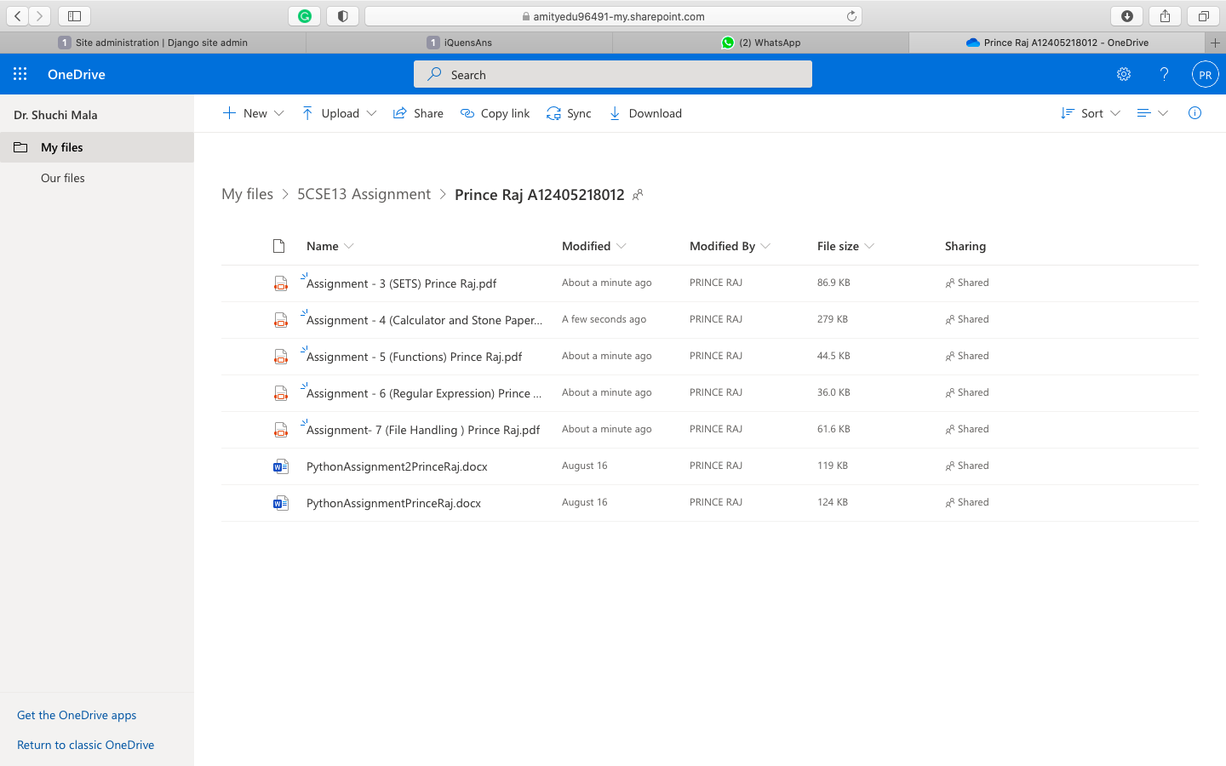

Slide 15
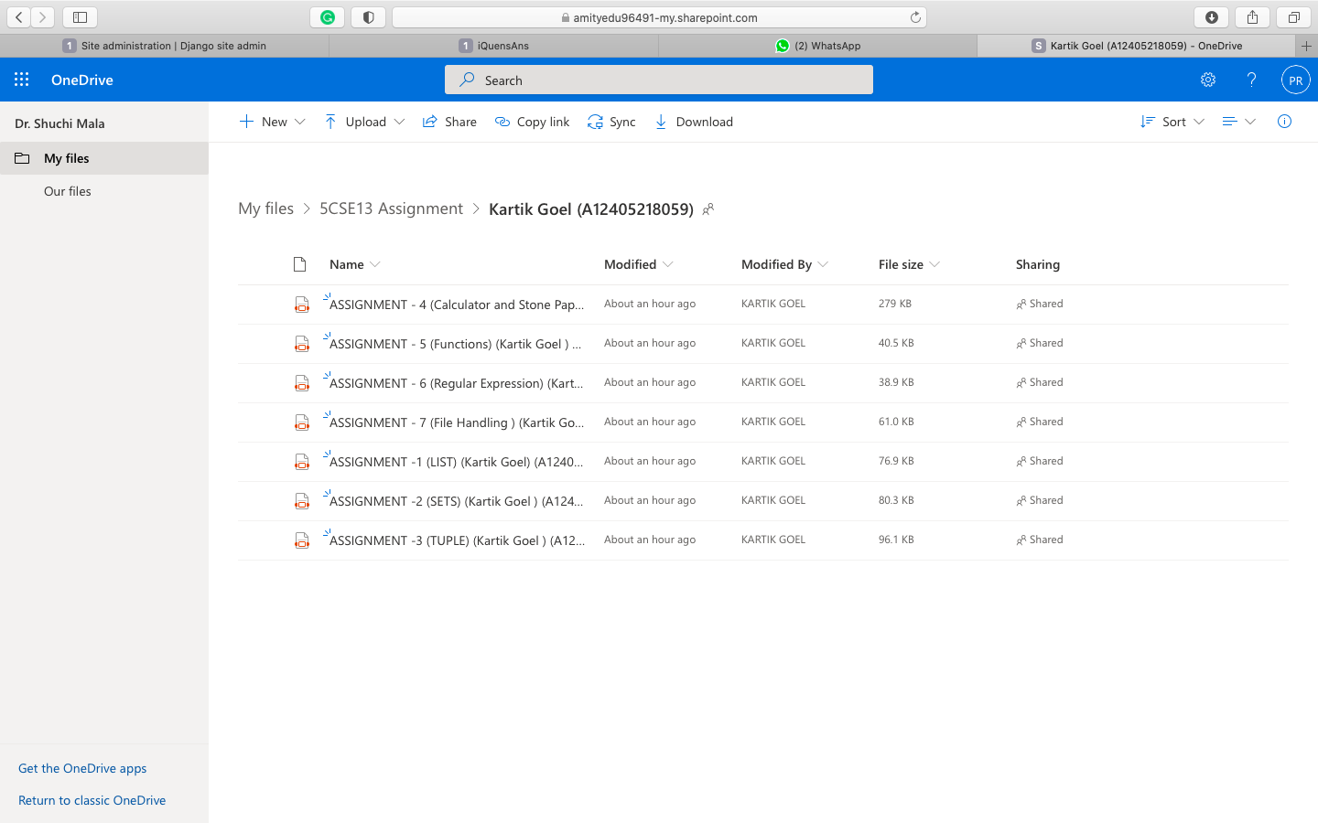

Slide 16
Thanks
For Today

